Slide 1
Shaders
Hosein Ghahremanzadeh
Notes:
The background is a sample of volumetric lighting in my own 3D graphics engine, HG3D

Slide 2

What is a Shader
Shaders are programs that were originally used for shading.
Shaders now perform a variety of special tasks.
Shaders are typically run on the GPU.

Slide 3
Shader Languages
Like any other programs, shaders are written in a language.
OpenGL provides a language for shader programming called GLSL.
Like any other languages shaders need to be compiled before execution.
This compilation could be done offline or on runtime.
Notes:
We will only discuss the runtime compilation of shaders.

Slide 4
OpenGL Program Model
OpenGL Program
Vertex Shader
Other Shaders
Fragment Shader

Slide 5

Programs
Programs are used to interface shaders.
A program can hold several shaders such as vertex shader, and fragment shader.
Programs are identified by an ID (IDs are typically of type $GLuint$, which is an unsigned integer).
The default program’s ID is 0.

Slide 6

Creating Programs
Programs are a kind of recourse on OpenGL.
Resources are to be created before use, and deleted after wards.
To create a program we use $glCreateProgram$ function, which creates a program and returns its ID.
It is important to save this ID for further use, and deletion of program.

Slide 7
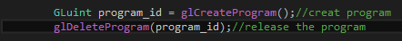

Deleting Programs
It is necessary to release the recourses that you have no use for any more.
For programs $glDeleteProgram$ deletes the program.
$glDeleteProgram$ gets the program ID as an input parameter and deletes the program.
The program ID after execution of this command is no more a valid program ID.

Slide 8

Quick Note
OpenGL as we know is a state machine.
Errors are an state of this machine.
The last error after execution of each command is retrievable by the $glGetError$ function.
Not that $glGetError$ removes the previous error upon execution.

Slide 9

Creating Shaders
Like any other recourses shaders are to be created before use.
$glCreateSahder$ creates a shader, and accepts an input parameter which defines the type of shader being created.
Shaders are identified by an ID, $glCreateSahder$ returns the ID of the shader being created.
It is necessary to store this ID for further use of the shader.

Slide 10
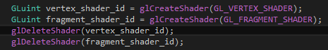

Deleting Shaders
Like any recourses, shaders are to be released after use, this is done by $glDeleteShader$ function.
$glDeleteShader$ gets the shader ID and releases the shader.
After the shader is deleted, its ID is no more valid.

Slide 11
Runtime compilation of shaders
Shaders can be compiled at runtime.
Shader source should be defined before compilation.
Compilation could result in compile error, which is as well state of the OpenGL state machine.

Slide 12

Define the shader source
$glShaderSource$ assigns source to a shader.
It is possible to assign several sources to a shader.
$glShaderSource$’s input parameters are as follows:
Shader ID, Source Count, Array of Sources, Array of Source Lengths
Notes:
If null is passed as array of source lengths, each source is considered a null terminated string. Otherwise each length corresponds to each source.
If a negative length corresponds to a source, the source is assumed to be a null terminated string.

Slide 13

Compiling shaders
$glCompileShader$ compiles the shader after a source is assigned to it.
The ID of the shader to be compiled is passed as input parameter.

Slide 14

Compilation Status
Compiling a shader changes its state.
One of the states that changes is the compilation status.
This state is retrievable via $glGetShaderiv$ function.
If $result$ is $GL_FALSE$ the compilation was no successful.
Additional info on why the compilation failed is retrieved by other functions.
Notes:
The $iv$ part on the shader names shows that this functions returns an integer state of the shader.
The state that we are looking for is passed as input parameter, where here $GL_COMPILE_STATUS$ has been passed to the functions.
The $result$ variable is passed by pointer, and is an output parameter, since the state is written to it, and returned.

Slide 15
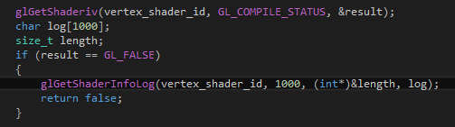

Shader Info Log
The $log$ is an output parameter, and the log is written to it.
The length variable is passed by pointer and is an output parameter and holds the length of the log, after the function is called.
The function is as well given the maximum length of the buffer (which here is $1000$), to avoid access out of bounds.
Notes:
The info log is as well a state of the state machine.
The compilation errors such as syntax error, will appear on the info log.

Slide 16

Attaching Shaders to Program
Shaders on themselves are not interfaceable.
Programs are used to interface shaders.
Shaders are attached to programs, this is done via $glAttachShader$ function.
$glAttachShader$ takes a program ID and a shader ID and attaches shader to program.
A single shader can be attached to several programs.

Slide 17
Shader Binding Points
Vertex shaders have input variables that will receive the vertex data.
Fragment shaders have output variables that will output the color data.
These input variable and output variables need to connect to the main program.
This is done via binding.

Slide 18
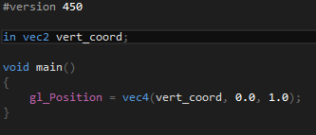

Binding Vertex Attributes
$glBindAttribLocation$ is used to assign the vertex shader input attributes (which will receive the vertex data) an index.
This attributes can later be referred to via this index.
Before binding, the shader must be compiled and attached to the program.
Notes:
In this example $vert_coord$is an input variable for a vertex shader and the $glBindAttribLocation$ assigns index 0 to this variable.
Variable name is passed to $glBindAttribLocation$ as well.

Slide 19
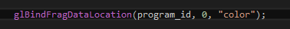
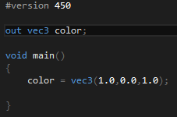

Binding Fragment Data
$glBindFragDataLocation$ is used to assign a color number to fragment shader output color.
The color number is later used to decide the color buffer the data is supposed to be written to.
Before binding, the shader must be compiled and attached to the program.
Notes:
In this example the $color$ variable of the fragment shader is assigned the color number 0.

Slide 20

Linking Program
After attaching shaders, and binding variables the program should be linked.
After linking the program is ready to use, unless the program doesn’t link properly.
The link status is retrievable by $glGetProgramiv$.
If link fails $GL_FALSE$ will be written to $result$ variable which is pass as a pointer.
More specific info on why the link failed can be retrieved by other functions.
Notes:
$glGetProgramiv$ as its name suggest returns the value of an integer state of a program, here the $GL_LINK_STATUS$ is returned via $result$ output parameter.

Slide 21
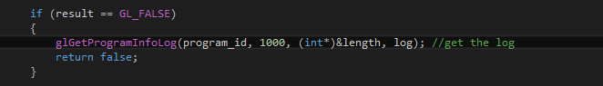

Program Info Log
$glGetProgramInfoLog$ writes the log of the program into a buffer.
The log length is return by an output variable (in this example $length$).
The max buffer size is passed to function to avoid access out of bounds.
Notes:
$glGetProgramiv$ as its name suggest returns the value of an integer state of a program, here the $GL_LINK_STATUS$ is returned via $result$ output parameter.

Slide 22
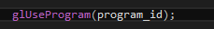

Using Program
To use program we should change the state of the pipeline to use our program.
This is done using the $glUseProgram$ function, which sets the current program for rendering.
It receives a program ID and changes the state of the pipeline accordingly.
Notes:
$glUseProgram$ can be called on default program to set the pipeline state on default.

Slide 23
Putting It All Together
Create Program
Create Shaders
Assign Sources to Shaders
Compile Shaders
Bind Fragment Data
Attach Shaders
Bind
Vertex Attributes
Link Program
Notes:
$glGetProgramiv$ as its name suggest returns the value of an integer state of a program, here the $GL_LINK_STATUS$ is returned via $result$ output parameter.

Slide 24

Your questions

Slide 25
Helpful links

